Slide 1
Session
Regain control with Azure Governance
Sam Cogan

Slide 2











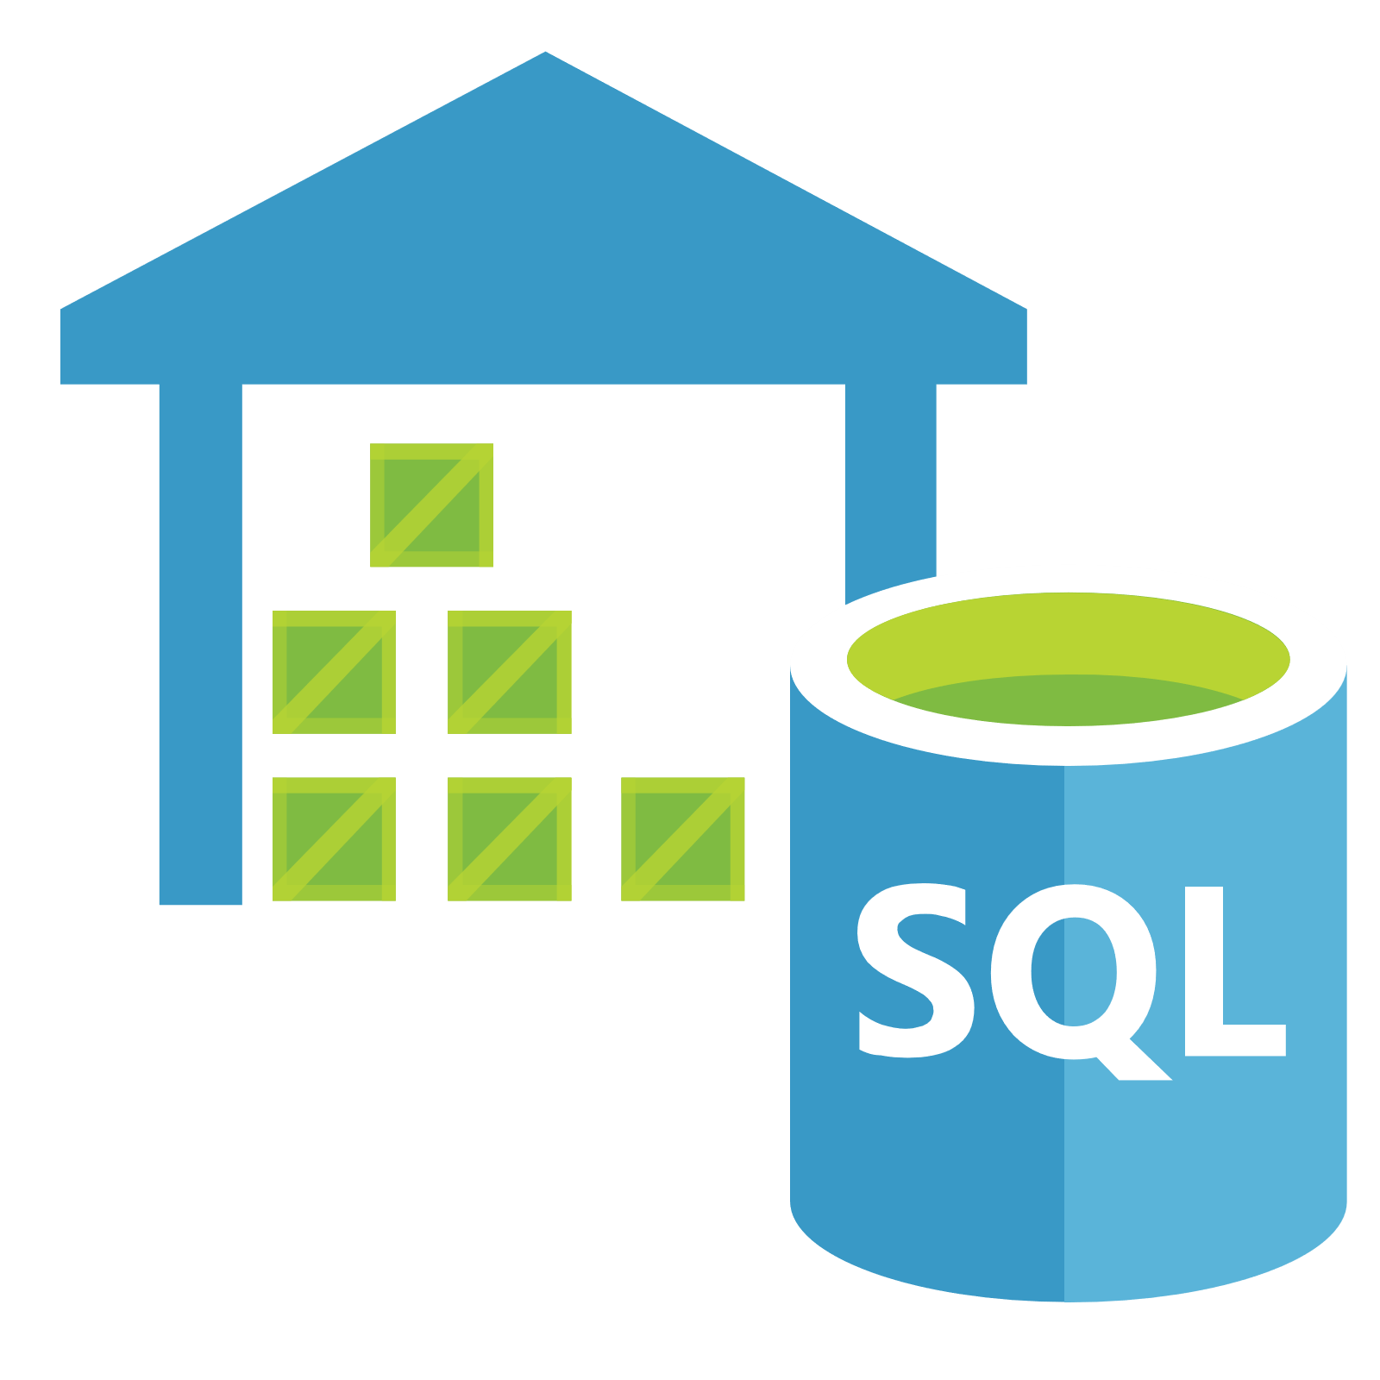
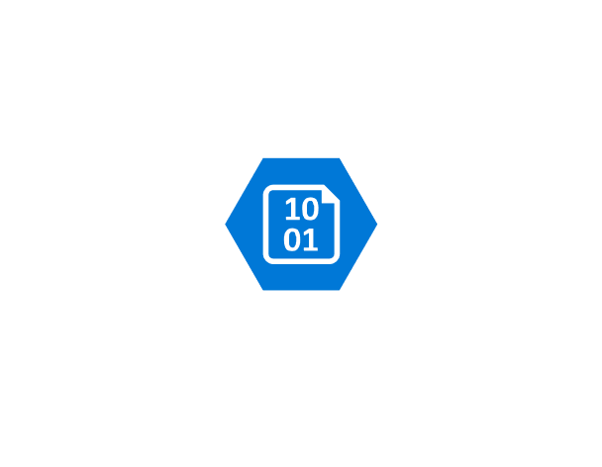













Taking Back Control

Slide 3





Sam Cogan
Solution Architect – Willis Towers Watson
Microsoft Azure MVP
samcogan.com
@samcogan
sam-cogan

Slide 4



Taking Back Control
Cost
Security
Compliance

Slide 5
Taking Back Control
Review
Organise
Audit
Enforce

Slide 6




Review
How much are we spending?
What resources are we spending it on?
Where are we out of compliance
Where should we focus our effort?

Slide 7



Review
Resource Graph
Cost Management
Security Centre

Slide 8



Organise
Create a subscription hierarchy
Classify Subscriptions and Resources
Apply access rights consistently

Slide 9



Organise
Management Groups
Tags
RBAC
Notes:
Demo management group setup
Apply RBAC to management groups
Tag application

Slide 10
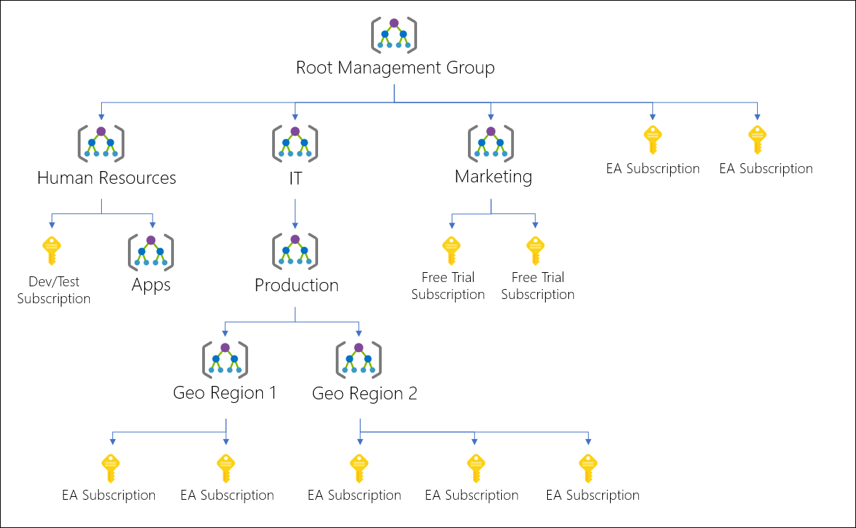
Management Groups

Slide 11

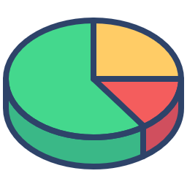

Audit
Develop Policies
Apply Budgets
Audit the impact of these policies
Get ready for enforcement
Notes:
Policy creation, show code
Policy Type:
Deny: generates an event in the activity log and fails the request
Audit: generates a warning event in activity log but doesn't fail the request
Append: adds the defined set of fields to the request
AuditIfNotExists: enables auditing if a resource doesn't exist
DeployIfNotExists: deploys a resource if it doesn't already exist
Disabled: doesn't evaluate resources for compliance to the policy rule
Language - https://docs.microsoft.com/en-us/azure/governance/policy/concepts/definition-structure#policy-rule
Initiatives

Slide 12

Audit
Cost Management
Azure Policy

Slide 13


Enforce
Change policies to enforcement
Add resolution actions
Enforce Budgets
Create new subscriptions already compliant

Slide 14

Enforce
Azure Policy
Cost Management
Azure Blueprints

Slide 15
Taking Back Control
Review: Cost Management Resource Graph Security Centre
Organise: Management Groups Tags Roles
Audit: Policies Budgets
Enforce: Policies Blueprints Budgets

Slide 16


Review
Understand what you are spending & why
Know that only approved resources are deployed
Know that you are adhering to security best practice
Further improvement!

Slide 17
Sam Cogan
Solution Architect – Willis Towers Watson
Microsoft Azure MVP
samcogan.com
@samcogan
sam-cogan

